Slide 1

E-commerce Records Analysis Report
Helena Li, Data Analyst
JR Academy

Slide 2
Report Content
business Purpose
Sales Data Exploration
Data Clustering
Recommendation

Slide 3
Business Purpose
Explore customer’ past behaviour and predict customer behaviour in the next sales period
Discover customer’ preferences in department, aisle, and product.
Discover the peak order time
Explore the pattern hidden in the data

Slide 4
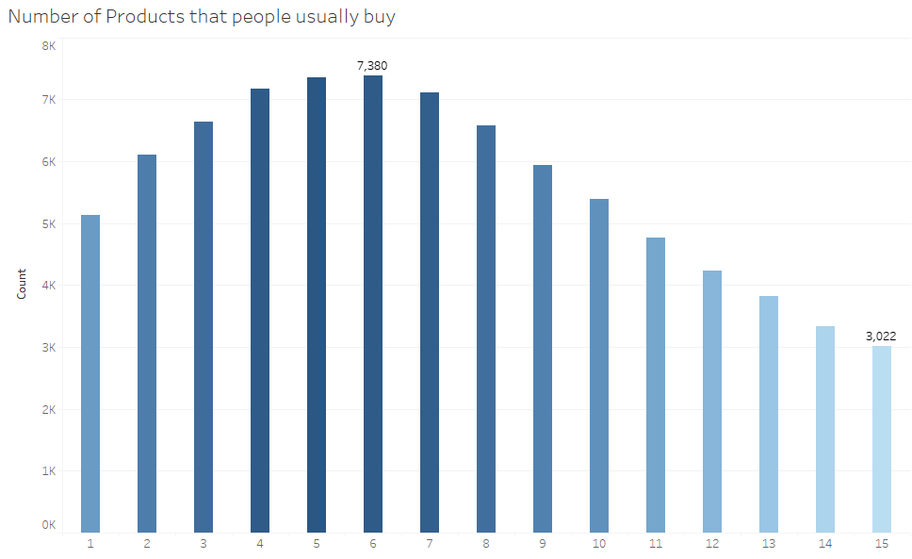
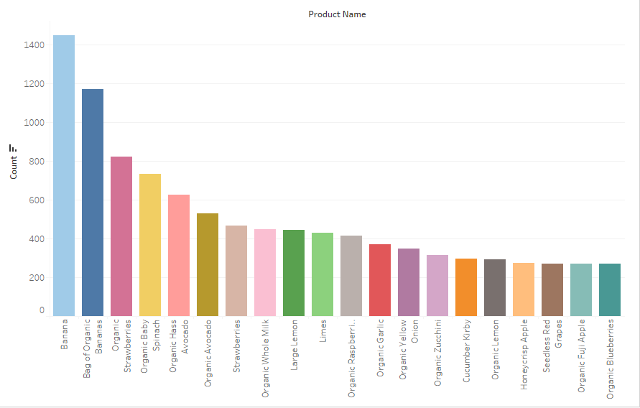
Data Exploration -Number of products that people usually buy
-Popular Product

Slide 5
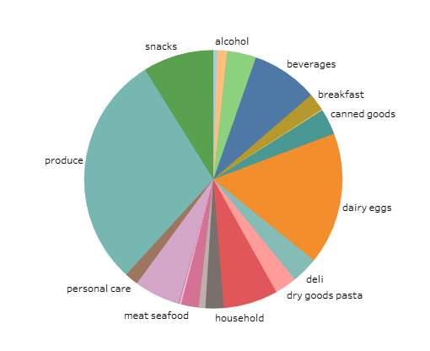
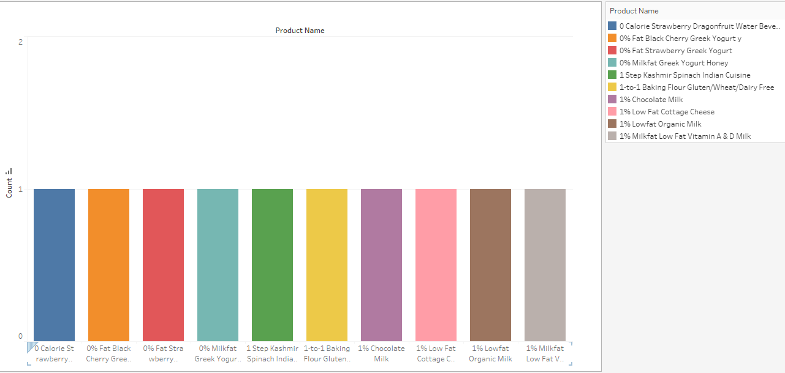
-Department Distribution
-Unpopular Product
Produce: Agricultural products collectively, especially vegetables and fruits.

Slide 6
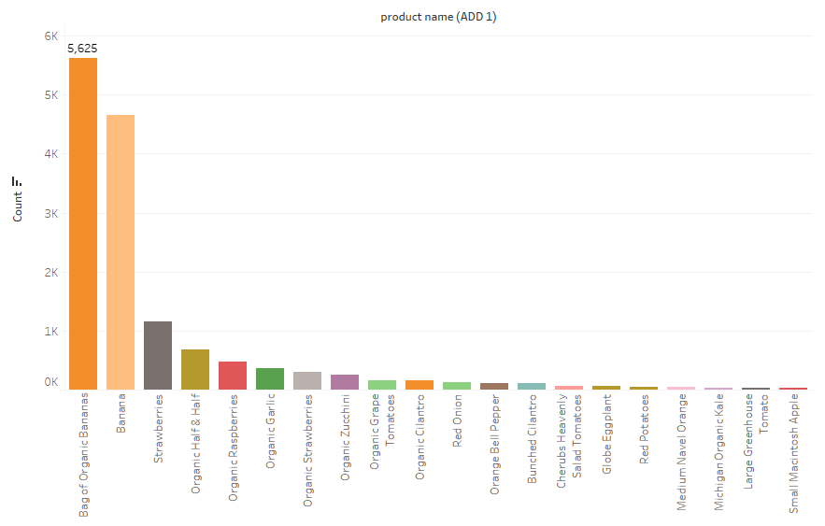
-Popular Product when add to cart is 1

Slide 7
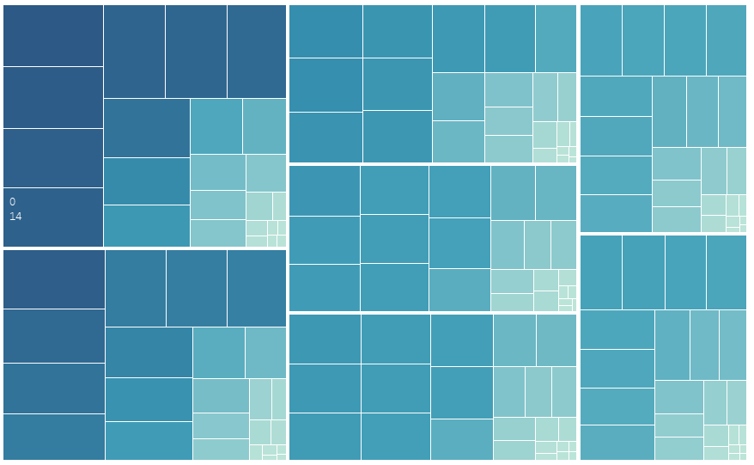
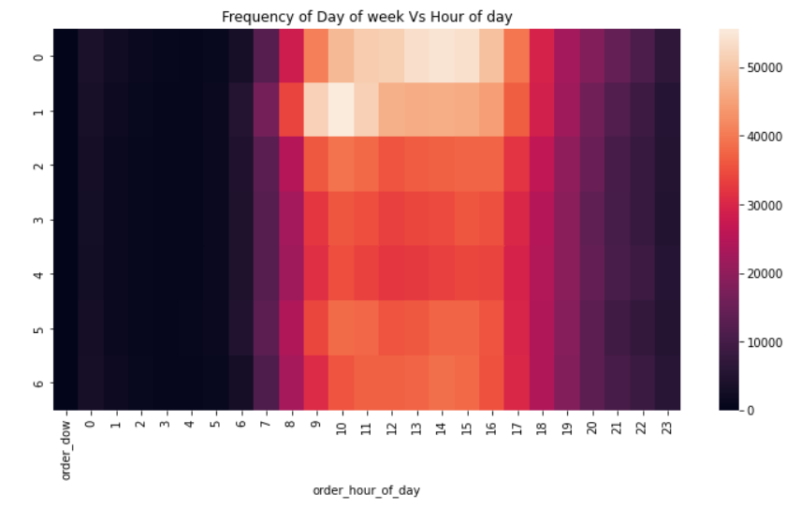
-Heatmap for order day of week and hour of time
Order day of week: 0 represents Sunday
Order hour of time: 14 represents 14 o’clock

Slide 8
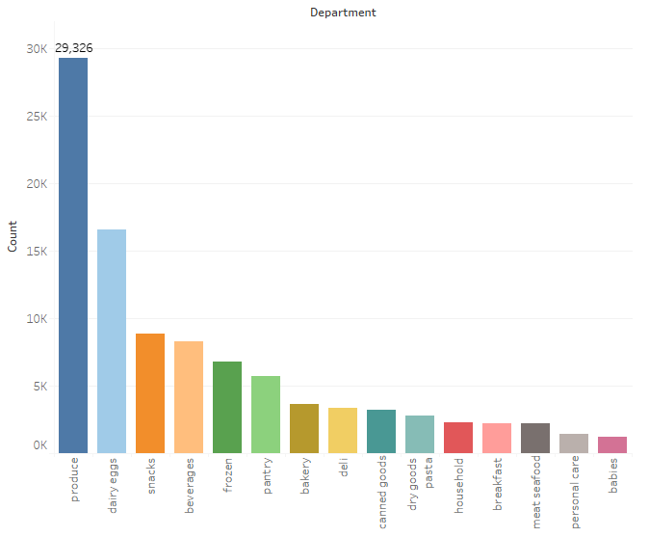
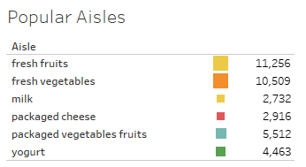
-Popular Department
-Popular Aisles

Slide 9
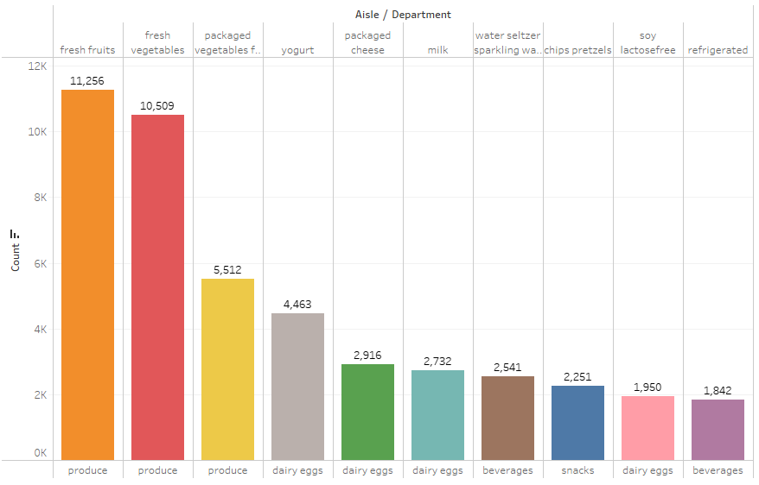
-Best Selling Aisles over All Departments

Slide 10
Data Clustering
Segregate groups with similar traits and assign them into clusters
Understand our customer better so that we can market our products better

Slide 11
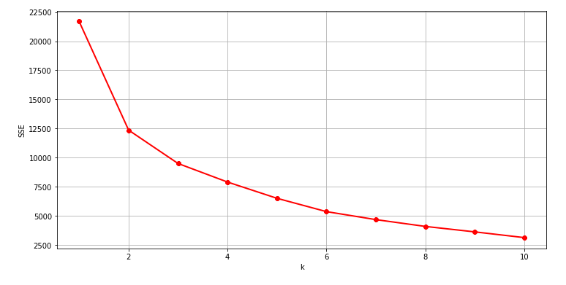
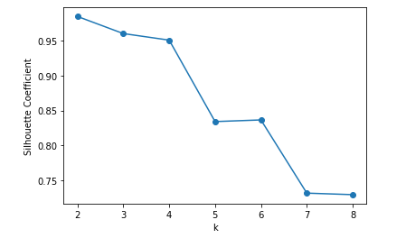
Data Clustering -Elbow Method
- Silhouette Coefficient Analysis

Slide 12
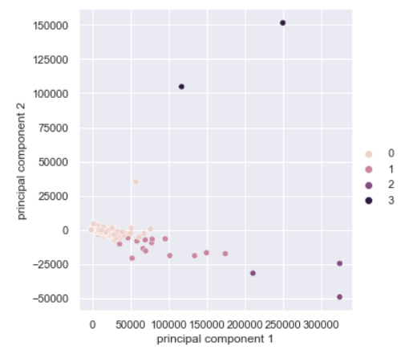
Data Clustering - Principal component analysis (PCA)
Reduce the dimensionality of a multivariate data to two or three principal components
Visualize data with minimal loss of information
Divide the customers into four categories

Slide 13
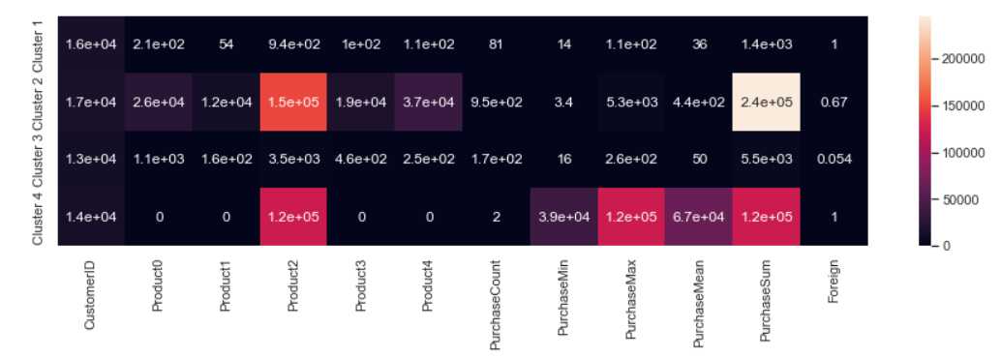
Data Clustering
Heatmap showing different features in each categories
Cluster 1 and 4 are purely composed of UK customers.
Cluster 2 has the largest purchase value sum and buys over all 5 products.
Cluster 4 only bought product 2 with only purchase twice while has a high purchase value sum. It means cluster 4 has bought expensive products.

Slide 14
Business Recommendation
Increase inventory and price of popular products like banana, bag of organic banana
01
Increase product categories in produce department
02
Ensure popular products’ inventory in peak order time e.g. by increasing company’s order channels
03
Reduce the price and inventory of unpopular products, e.g. through sales promotion of the 0 calories strawberry dragon fruit water beverage
04
Change product manufacturer of unpopular products
05

Slide 15
Thank You!

